Slide 1
Transformation

Slide 2
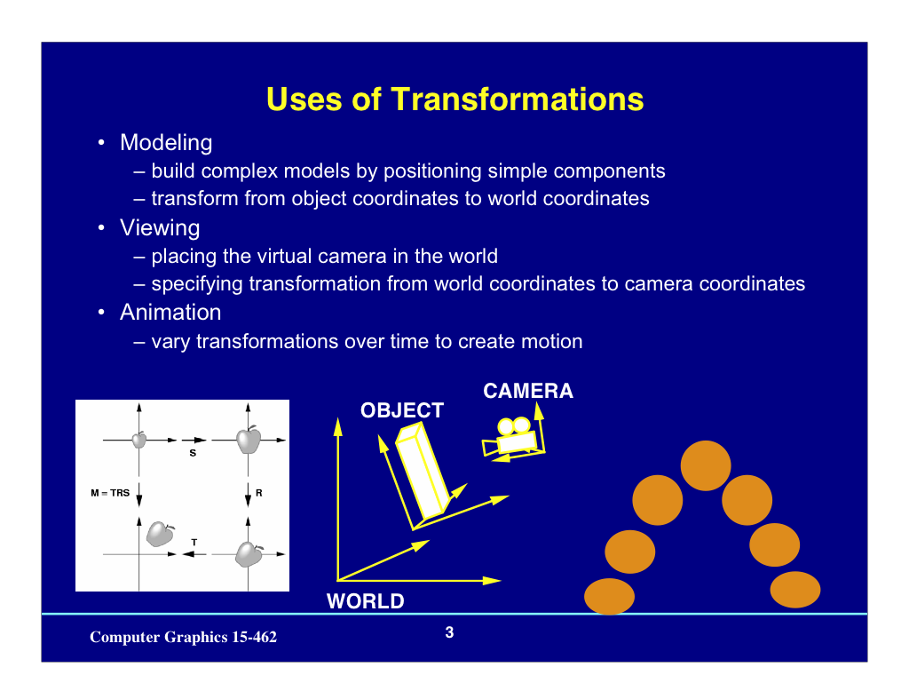

Slide 3
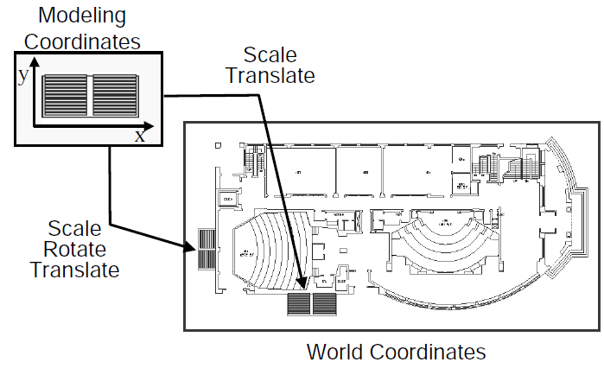
2D Modeling Transformations

Slide 4
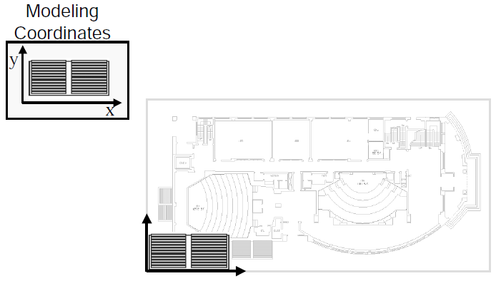
2D Modeling Transformations

Slide 5
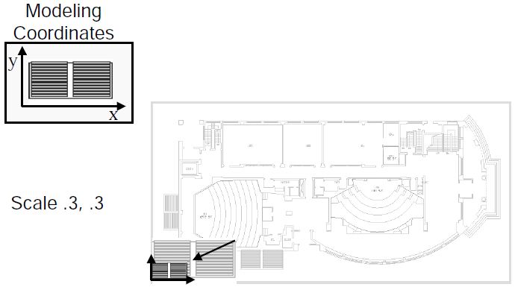
2D Modeling Transformations

Slide 6
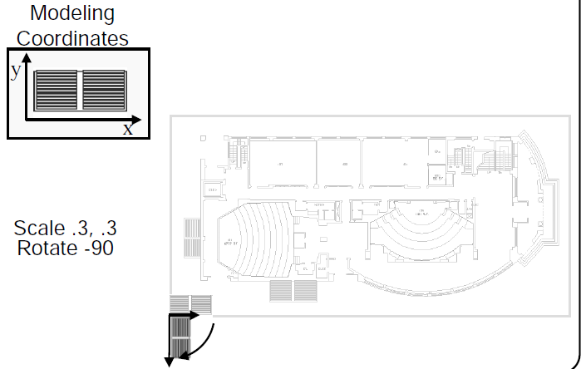
2D Modeling Transformations

Slide 7
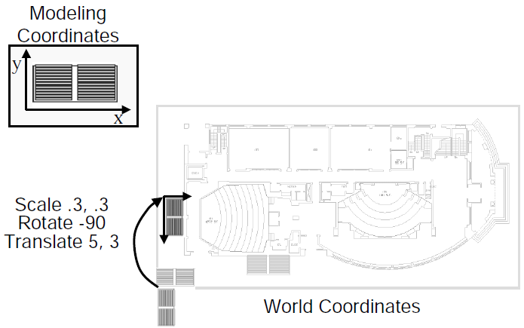
2D Modeling Transformations

Slide 8
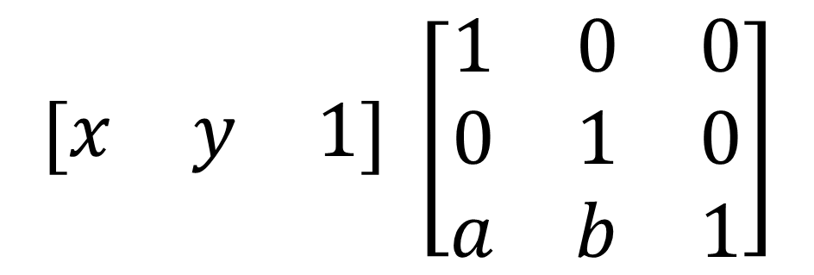

Basic 2D Transformations
Matrix Representation
Translation
$$\left[\begin{matrix}x & y & 1\end{matrix}\right] →\left[\begin{matrix}x+a & y+b & 1\end{matrix}\right]$$
$$\left[\begin{matrix}x & y & 1\end{matrix}\right] \left[\begin{matrix}1 & 0 & 0 \\ 0 & 1 & 0 \\ a & b & 1\end{matrix}\right]$$
$$→\left[\begin{matrix}x+a & y+b & 1\end{matrix}\right]$$

Slide 9
Basic 3D Transformations
Matrix Representation
3D Translation

Slide 10
Basic 3D Transformations
Matrix Representation
3D Translation

Slide 11
3D Translation

Slide 12
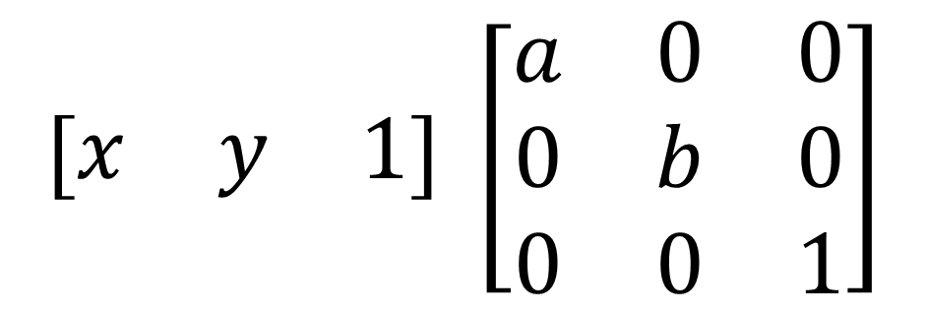

Basic 2D Transformations
Matrix Representation
Scaling
$$\left[\begin{matrix}x & y & 1\end{matrix}\right] →\left[\begin{matrix}ax & by & 1\end{matrix}\right]$$
$$\left[\begin{matrix}x & y & 1\end{matrix}\right] \left[\begin{matrix}a & 0 & 0 \\ 0 & b & 0 \\ 0 & 0 & 1\end{matrix}\right]$$
$$→\left[\begin{matrix}ax & by & 1\end{matrix}\right]$$

Slide 13
3D Scaling

Slide 14
3D Scaling

Slide 16
Uniform Scaling

Slide 18
Non-Uniform Scaling

Slide 19
Uniform Scaling about an arbitrary point
Step1 : Translate the object to the origin.
Step2 : Scale the object by given Scale factor.
Step3 : Translate the object back to the original position
These three steps can be combine with transformation matrix as below:
from right to left

Slide 21
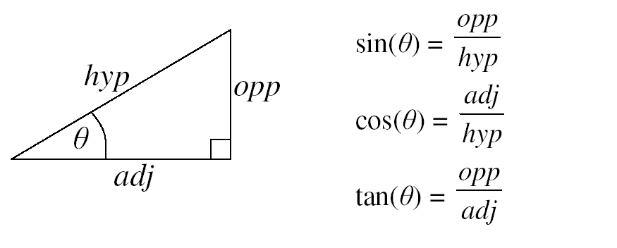

Slide 22
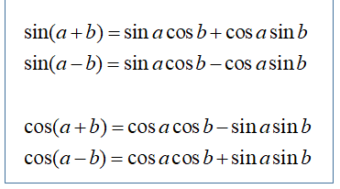

Slide 32
Many coordinate systems:
Camera
Static scene
Object, such as
car
driver
arm
hand
...
Moving car
points describe location of car elements
vectors describe velocity, distance between pairs of points
If I translate the moving car to a different road
The points (location) change
The vectors (speed, distance between points) don’t

Slide 33
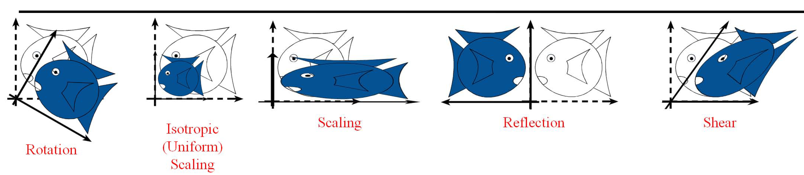
Linear Transformation

Slide 34
Points vs. Vectors
• A point is a location
• A vector is a motion between two points
• Adding vectors is meaningful
- going 3km North + 4km East = going 5km North-East
• Adding points is not meaningful
- Dhaka location + New York location = ?

Slide 35
Affine space
Points are elements of an affine space

Slide 36
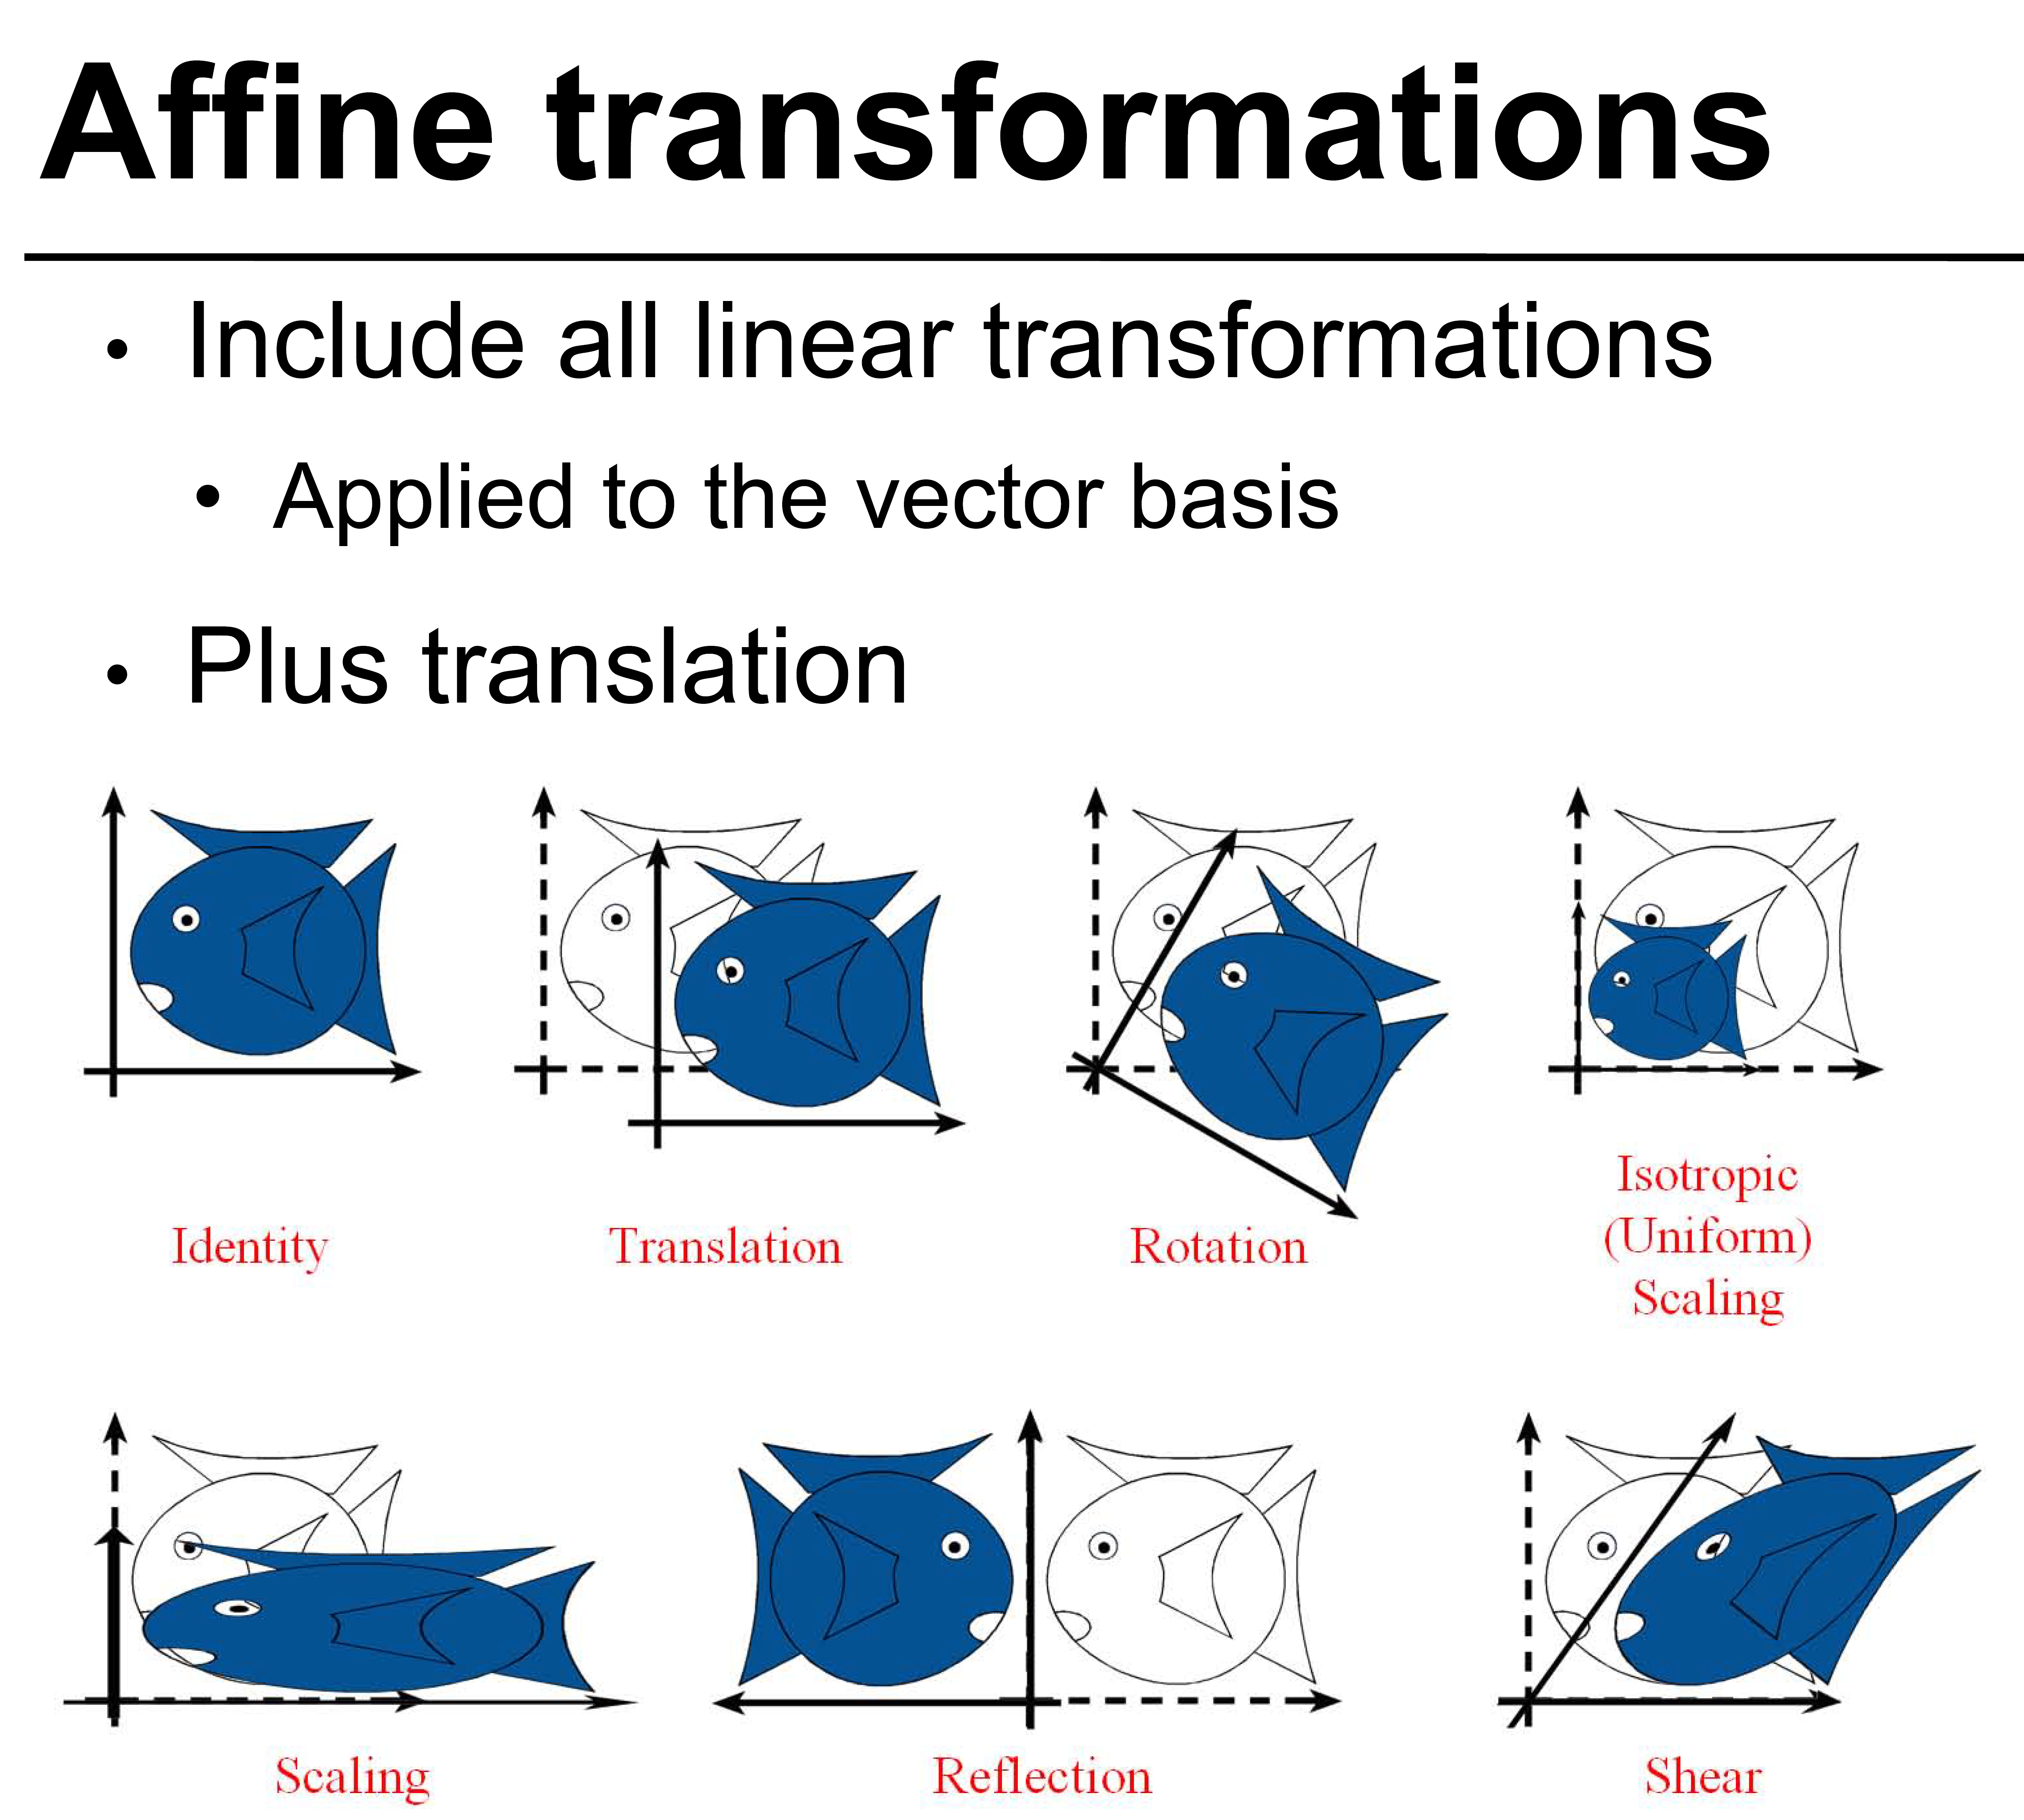

Slide 37
Frames & hierarchical modeling
Example: what if I rotate the wheel of the moving car:
• frame 1: world
• frame 2: car
• transformation: rotation
the transformation in world is A⁻¹BA
i.e., from right to left, A takes us from world to car, then we apply B (rotation), then we go back to world with A⁻¹

Slide 38
How are transforms combined?

Slide 39
Non-commutative Composition

Slide 40
